Slide 1
Self Driving RC Car
Ethan Wells
Abigail Duran
Ethan Bishop
Alexis Perez

Slide 2
Ethan Wells
Goals for the week
Train and test a CNN on the prepared LISA sign dataset.
Progress for the week
Trained and tested the LISA model: 89.90% top-1 (525 of 584 test crops) and 84.93% macro class accuracy.
Reviewed per-class results and found limited, uneven training data, including few independent sign tracks for several classes.
Sourced Mapillary data and prepared 3,449 crops for the same 12 classes: 2,655 train, 362 validation, and 432 test.
Goals for next week
Train and test a model on the prepared Mapillary data.
If time allows, combine the LISA and Mapillary datasets, then train and test the combined model.
Hours spent on progress: 7 hours

Slide 3



LISA Model Results
Test recall by class (%)
Misclassified test crops
True: Merge
Predicted: Added Lane
Recall: 52.6% (10/19)
True: School
Predicted: Pedestrian Crossing
Recall: 63.6% (7/11)
True: Speed Limit 30
Predicted: Speed Limit 35
Recall: 71.4% (15/21)
Overall: 89.90% top-1 · 84.93% macro class accuracy
Test scores use prepared crops; they do not measure BuggyBot’s live camera pipeline.

Slide 4





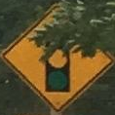



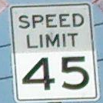
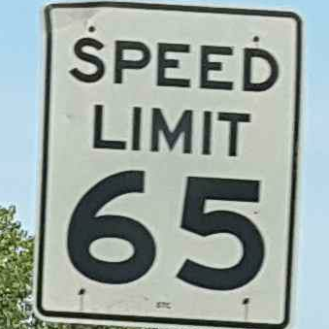
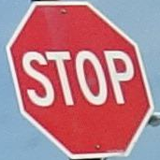
Mapillary Data Preparation
Prepared training crops · one example per class
Preparation
Sourced Mapillary road-scene images for the same 12 U.S. sign classes.
Prepared 3,449 cropped signs: 2,655 train, 362 validation, and 432 test.
Next: train and evaluate the model, then consider combining Mapillary with LISA.
Added Lane
Keep Right
Merge
Pedestrian
School
Signal Ahead
Speed 25
Speed 30
Speed 35
Speed 45
Speed 65
Stop

Slide 5
Alexis Perez
Goals for the week
  Continue OpenCV Learning
  Research Line Sensor Options
Progress for the week
  Selected and ordered Line Sensors
  Completed OpenCV Beginner course
Goals for next week
  Integrate line sensors with RaspberryPi
  Implement OpenCV with RaspberryPi Camera
Hours spent on progress
  6 hours.

Slide 6
Ethan Bishop
Goals for the week
  Research 3D printing stl files for the chassis
  Research possible ROS implementation
Progress for the week
  Researched 3D printing stl files for the chassis
  Continue research on a possible ROS 2 implementation
Goals for next week
  Continue research on a possible ROS 2 implementation
Hours spent on progress
  6 hours.

Slide 7
ROS 2 Implementation
What I have learned so far is that it could be possible to make ROS 2 into our pipeline, but it will take more upfront work.
The preliminary idea of a node structure
Camera node: Streams live 640×480 video to the rest of the system
Sign detector node: Runs our recognition model and reports each sign's type, confidence and position
Behavior node: A state machine that turns signs into driving decisions (stop, speed limit, turn)
Motor driver node: Converts speed and steering commands into motor signals on the HAT over I2C
Safety: Motors stop automatically if commands stop arriving, and a manual override is available
Why ROS 2: Modular nodes split the work across the team, and recorded drives can be replayed to test without the car

Slide 8
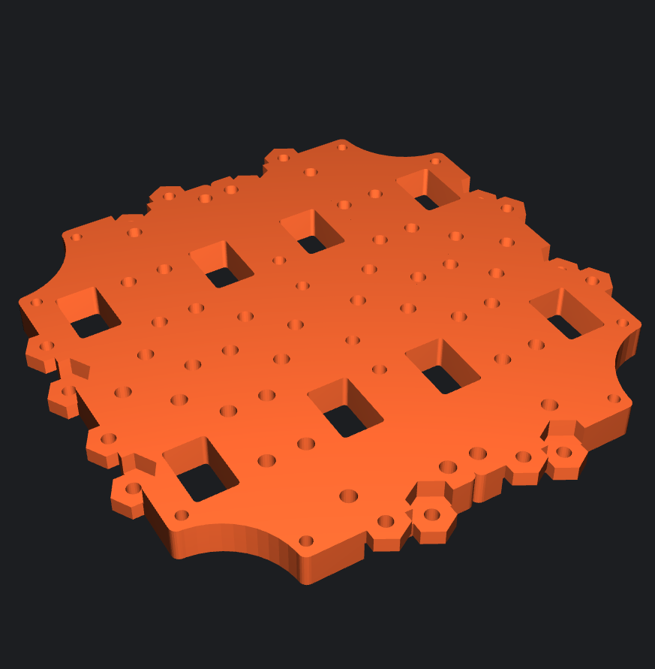
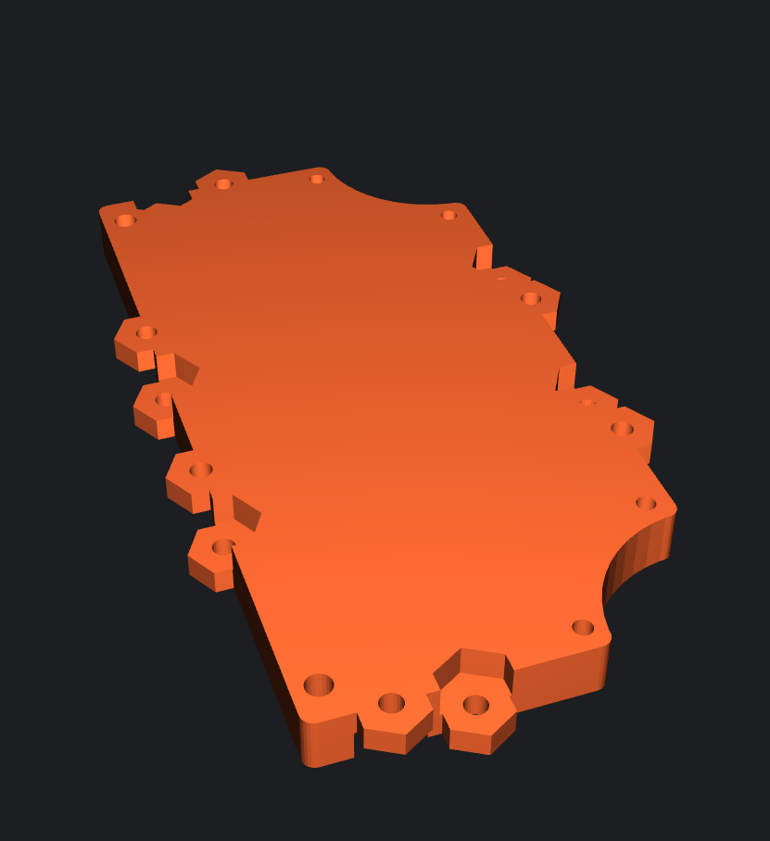
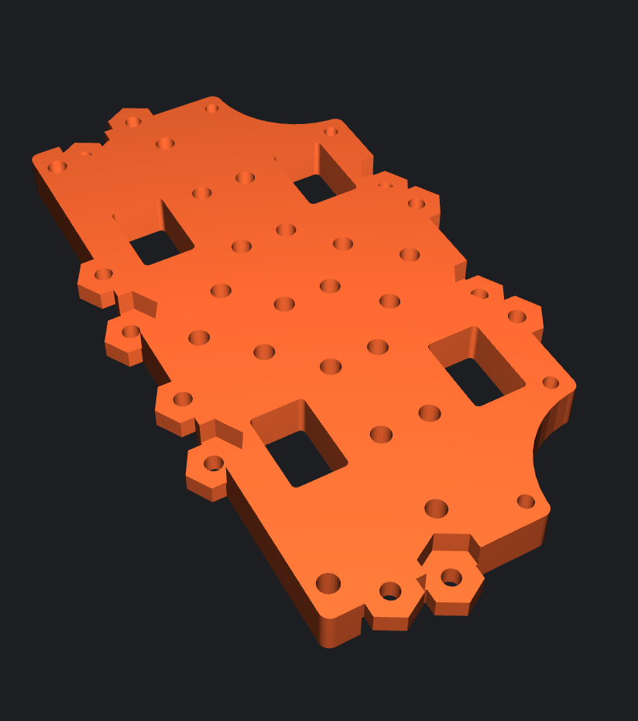
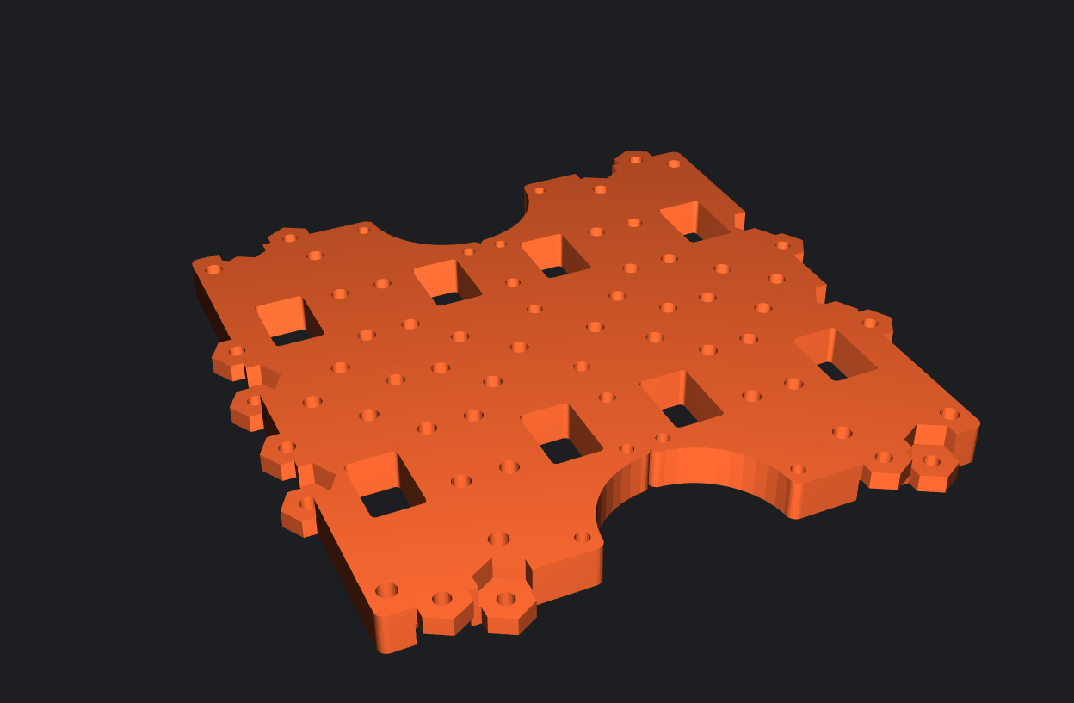
Waffle bot plates
I found some simplified Waffle plates on printables.com
One with no holes
One being a simple plate
Two being different doubles

Slide 9
Abigail Duran
Goals for the week
  Finalize the list of components and connections that will be included on the final PCB.
  Identify what parts of the CM5 IO board are necessary for the project.
Progress for the week
  Created an organized component checklist/spreadsheet for the PCB design.
  Reviewed the CM5 IO Board components and connections to determine which features should be kept, removed, or modified.
  Narrowed down the components needed for the final custom PCB.
Goals for next week​​​
  Begin planning the PCB layout, including component placement and board dimensions.​
  Begin planning power distribution and signal routing.​
  Start transferring the finalized component requirements into the PCB design.
Hours spent on progress
  6 hours​

Slide 10
